Slide 1

DBMS Project Report
Movie Database
Rohan C
‘F’ - Section
PES1UG20CS345

Slide 2
Short Description and Scope of Project
Creating a Movie Database which is able to store and quickly retrieve information.
Querying this database can give all relavent information regards to any title.
This Database consists of 11 Tables, whose description is as below
Titles – This table consists of all titles names along with their types - (tvSeries, Movie, etc) with their start/end years and runtime. They are uniquely identified by their ‘title_id’.
Names – This table consists of names of all the cast and crew who have worked on a particular project. It also consists of their birth and death years. They are uniquely identified by their ‘name_id’.

Slide 3
Short Description and Scope of Project
Aliases – In this table, the alternate movie titles, dubbed languages and region they are released for are stored.
Alias Types – Stores the details of movie whether original or remake.
Alias Attributes – Consists of the different types of titles for a movie.
Directors – This table consists of the ‘name_id’ of the directors and ‘title_id’ of all the movies they directed.
Writers - This table consists of the ‘name_id’ of the producers and ‘title_id’ of all the movies they produced.

Slide 4
Short Description and Scope of Project
Episode Belongs To – This table consists of the details of an episode of a TV Series and the Season that it belongs to.
Had Role – This table stores the role that each cast member had in a particular title.
Known For – This table consists of the roles in a title that a particular actor from names is most known for.
Principals – Consists of all the different types of jobs in a particular title and the names that worked in these roles.
Title Ratings – Consists of an average ratings of a particular title.
Title Genre – This table details the genre of each title.

Slide 5
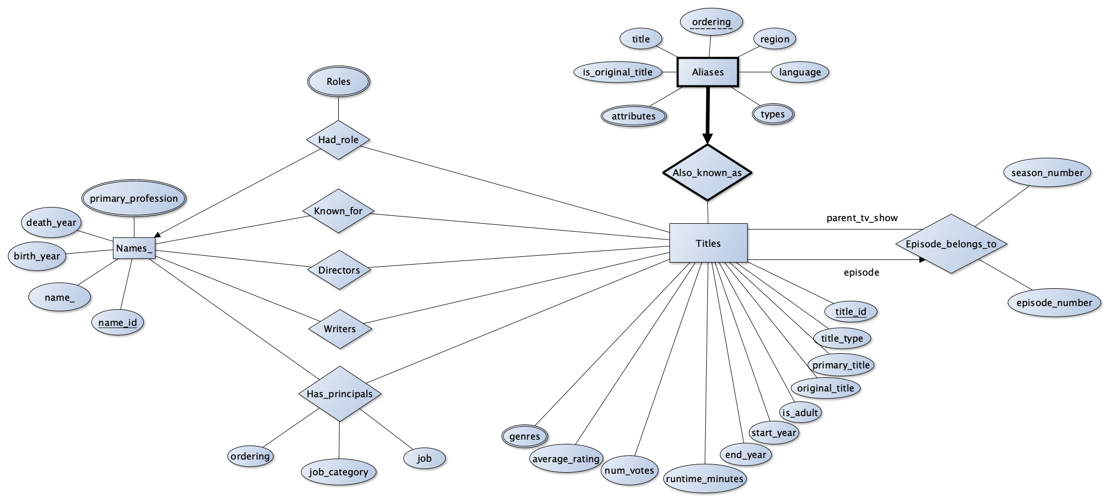
ER Diagram

Slide 6
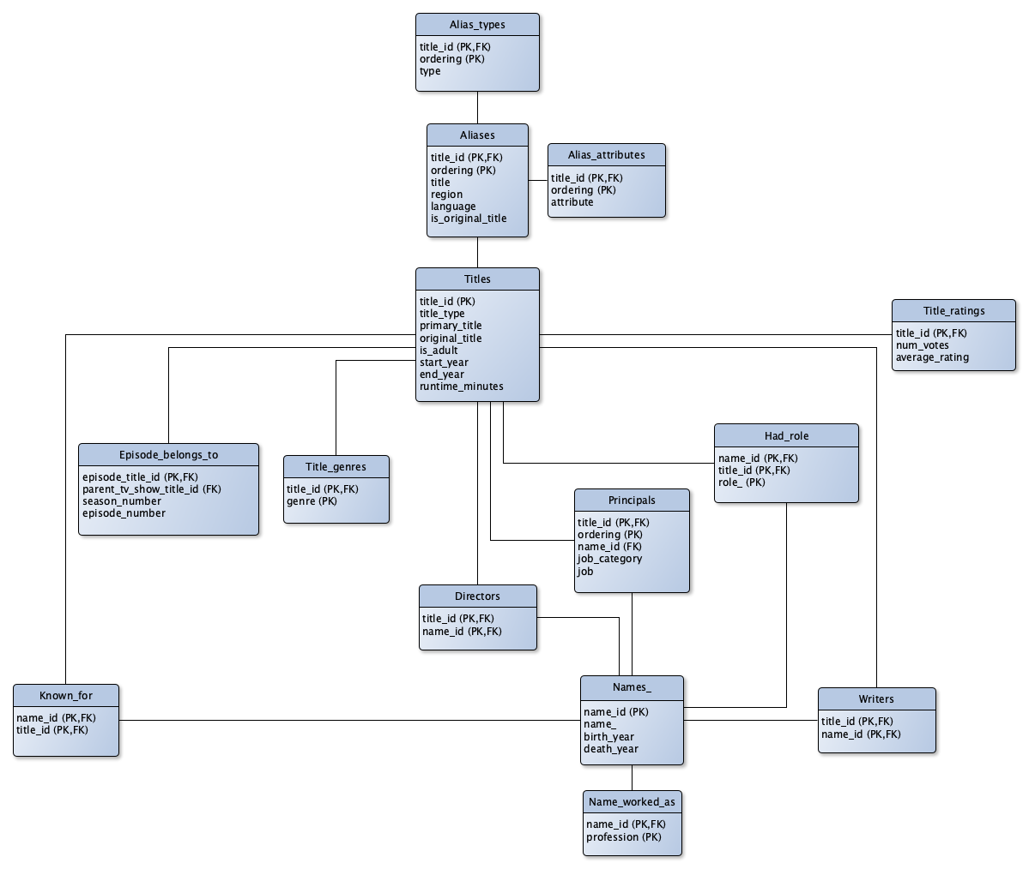
Relational Schema

Slide 7
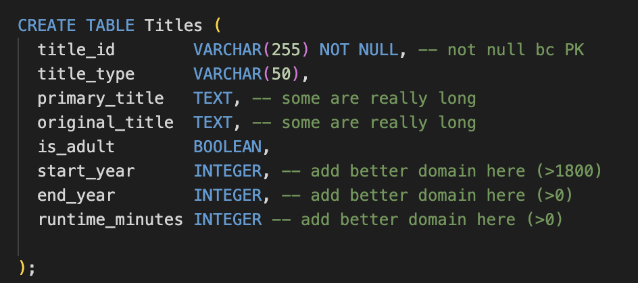
DDL statements – Building the Database

Slide 8
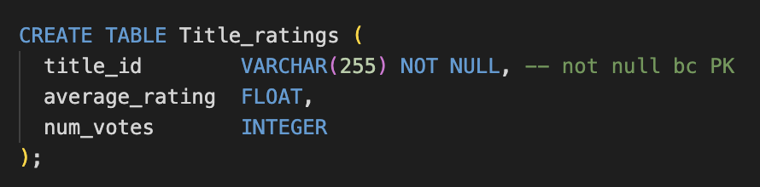
DDL statements – Building the Database

Slide 9
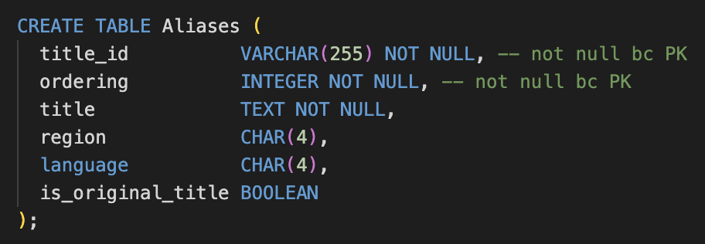
DDL statements – Building the Database

Slide 10
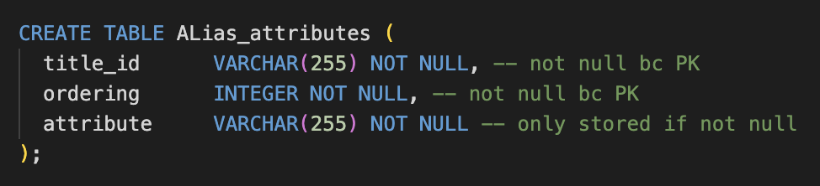
DDL statements – Building the Database

Slide 11
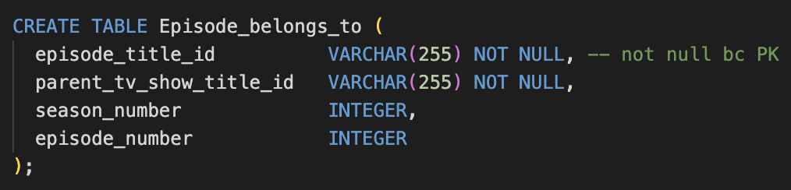
DDL statements – Building the Database

Slide 12
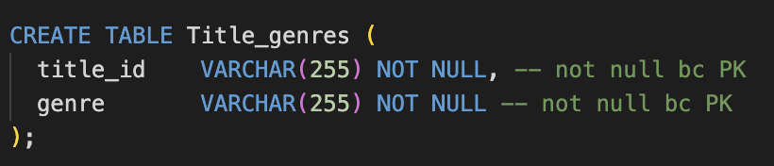
DDL statements – Building the Database

Slide 13
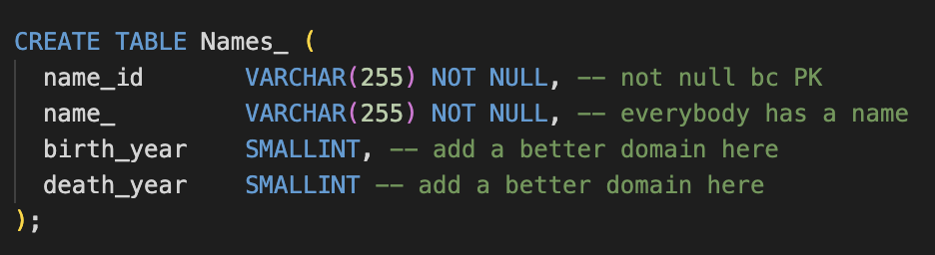
DDL statements – Building the Database

Slide 14
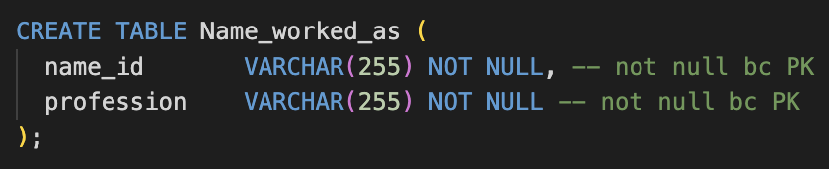
DDL statements – Building the Database

Slide 15
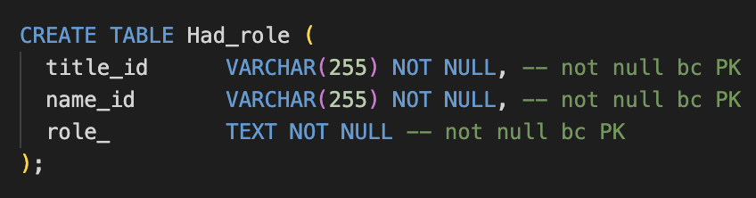
DDL statements – Building the Database

Slide 16
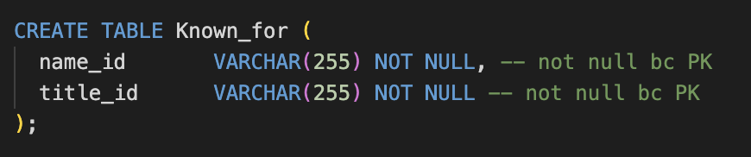
DDL statements – Building the Database

Slide 17
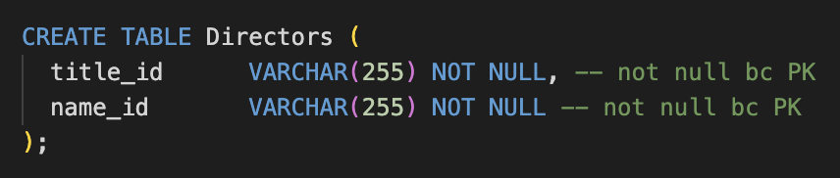
DDL statements – Building the Database

Slide 18
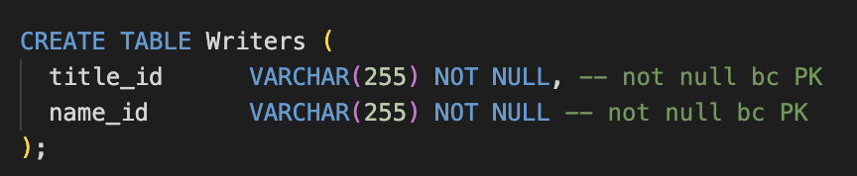
DDL statements – Building the Database

Slide 19
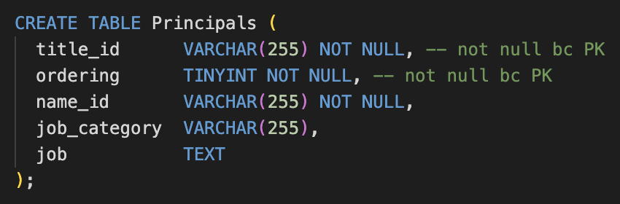
DDL statements – Building the Database

Slide 20
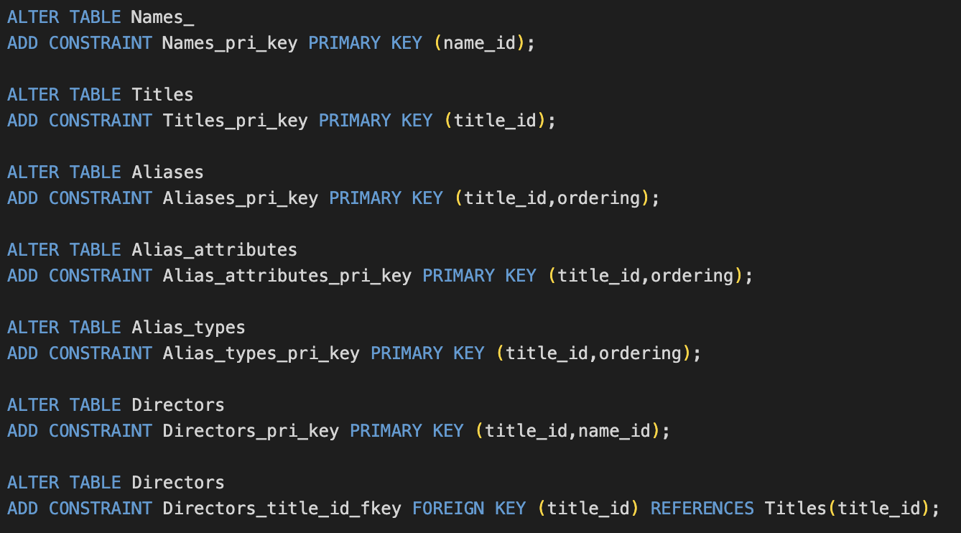
DDL Statements – Building The Database

Slide 21
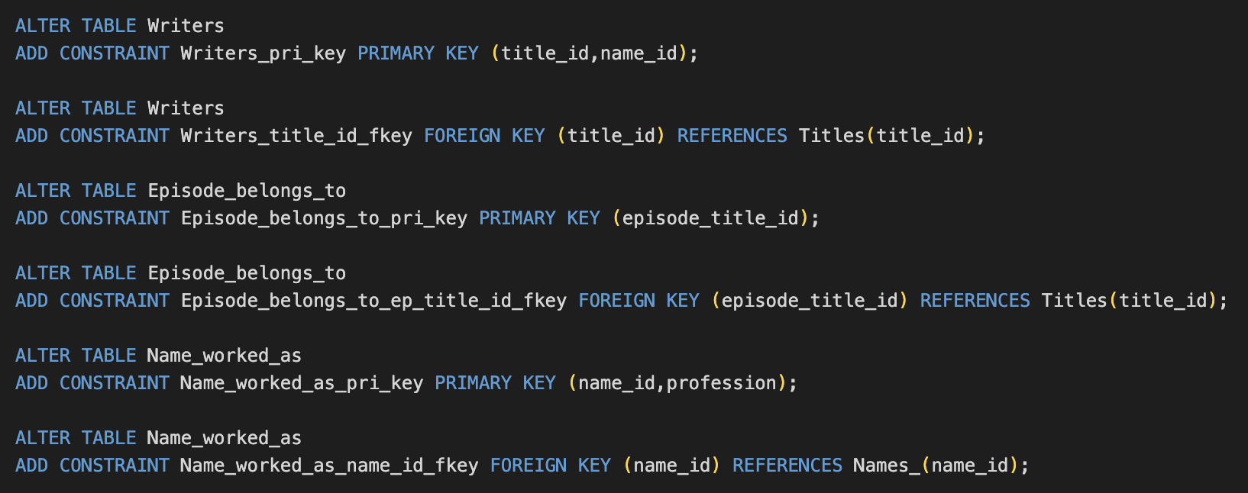
DDL Statements – Building The Database

Slide 22
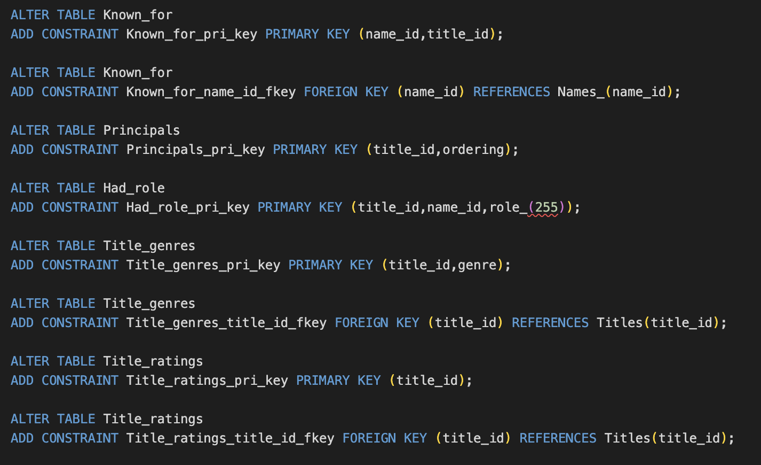
DDL Statements – Building The Database

Slide 23
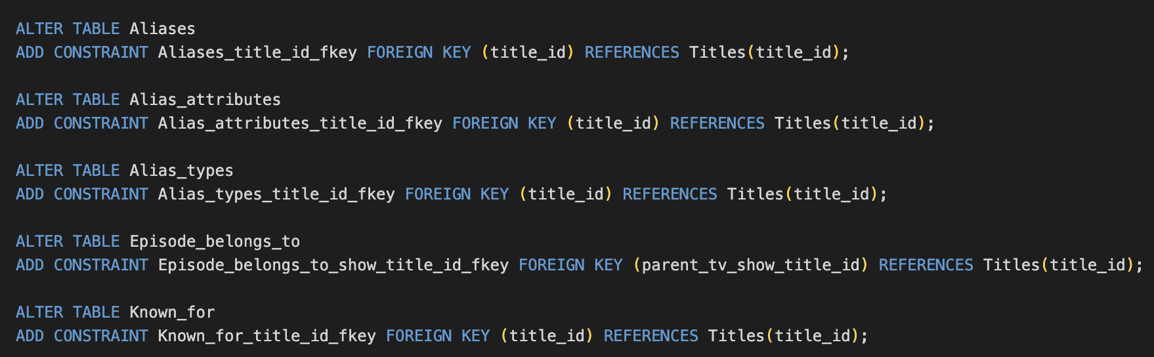
DDL Statements – Building The Database

Slide 24
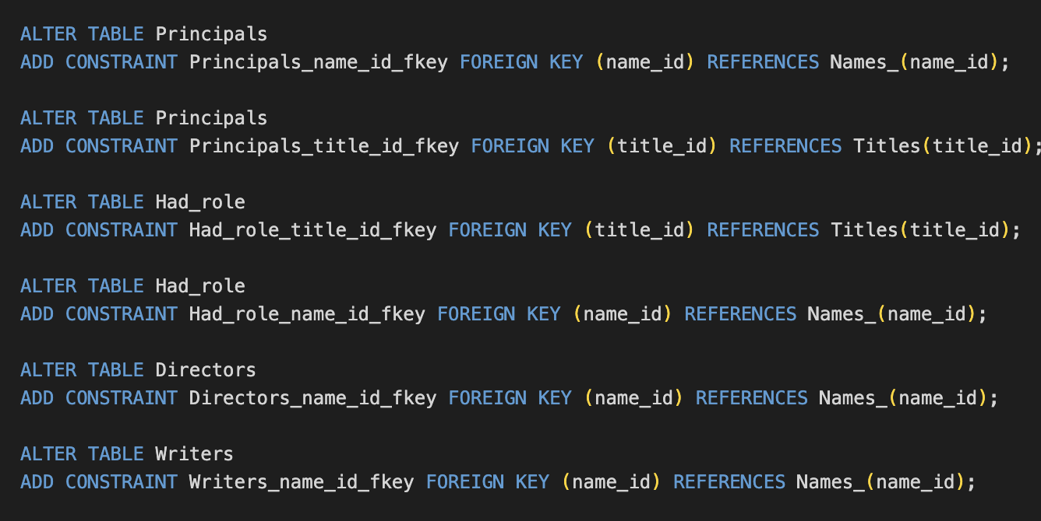
DDL Statements – Building The Database

Slide 25
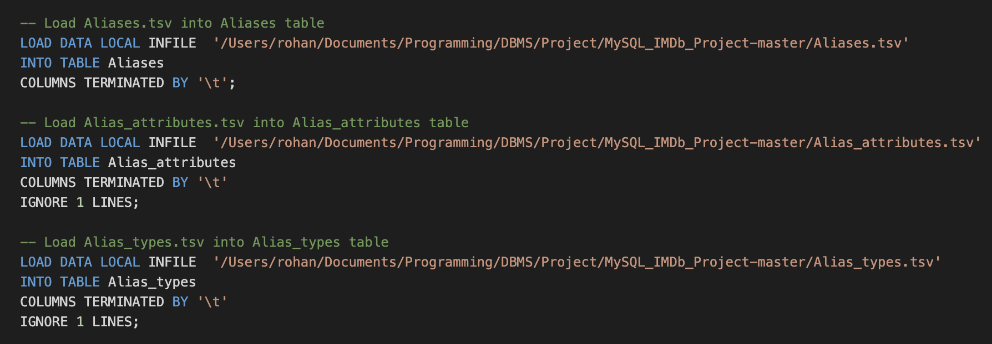
Populating the Database

Slide 26
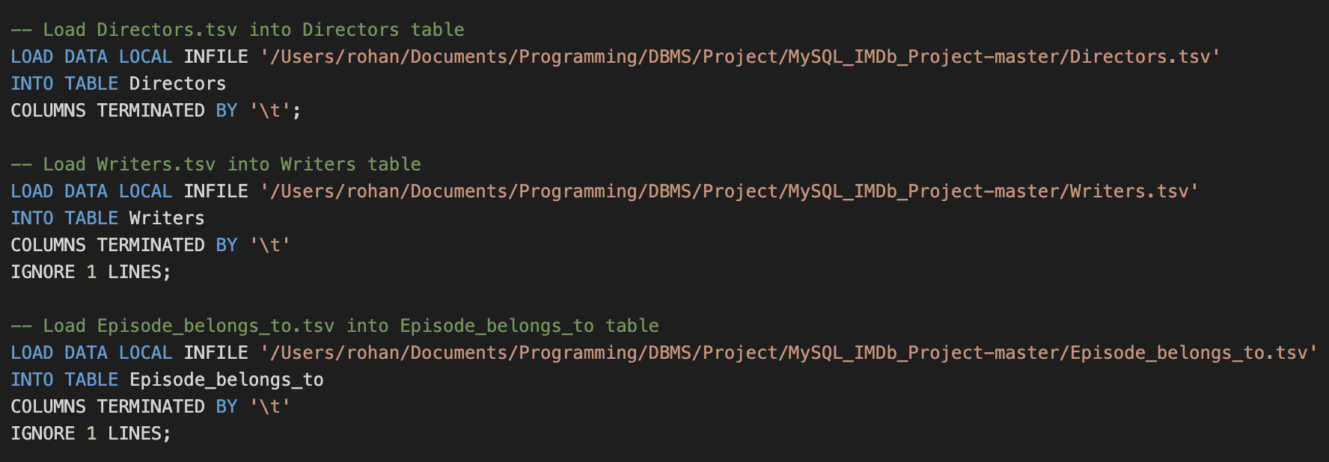
Populating the Database

Slide 27
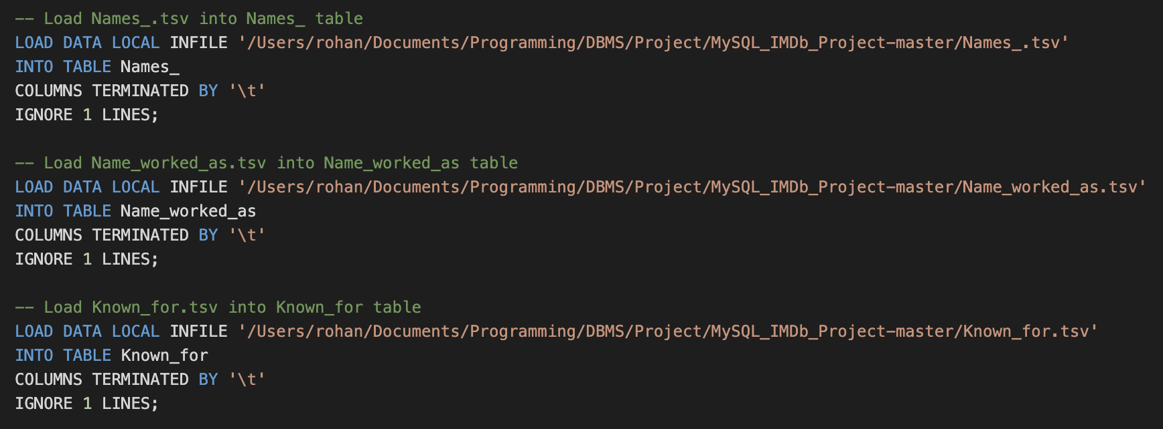
Populating the Database

Slide 28
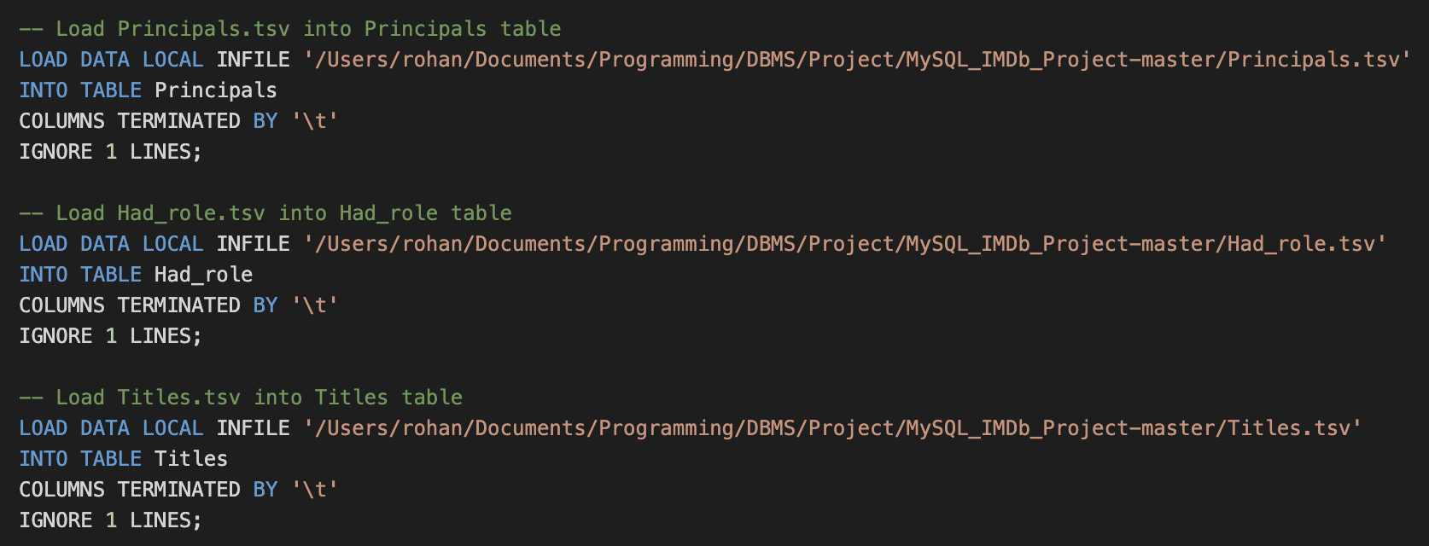
Populating the Database

Slide 29
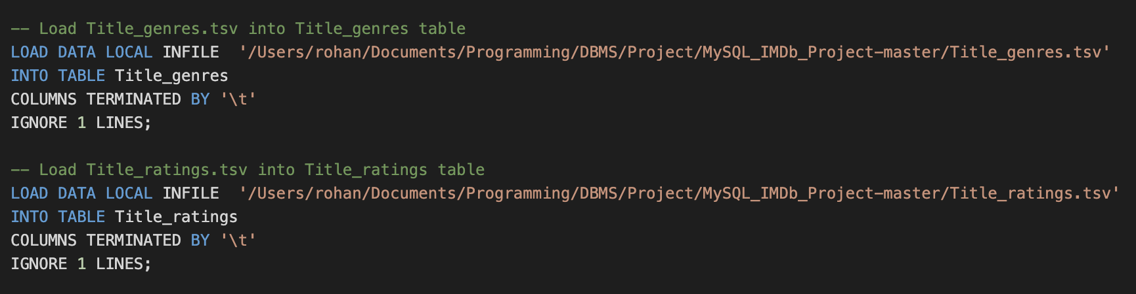
Populating the Database

Slide 30
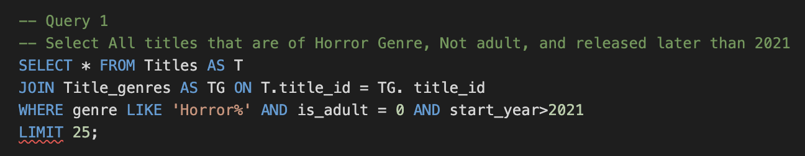
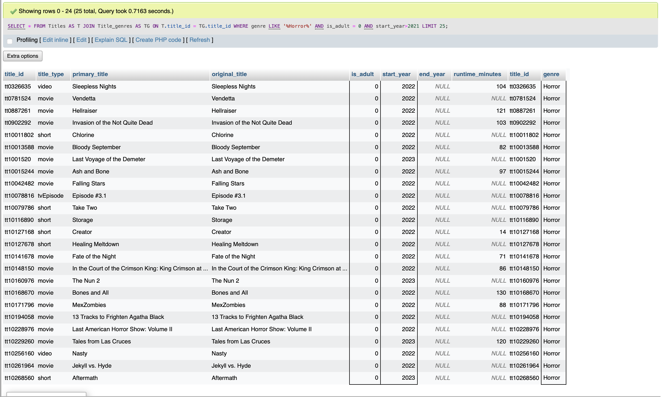
Join Query - 1

Slide 31
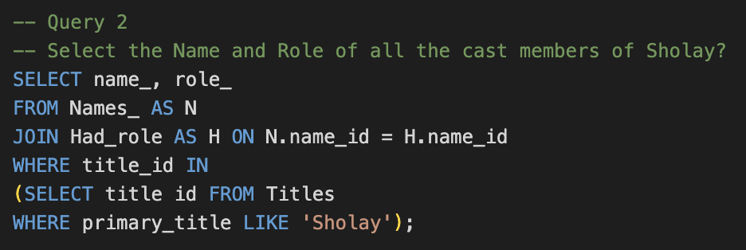
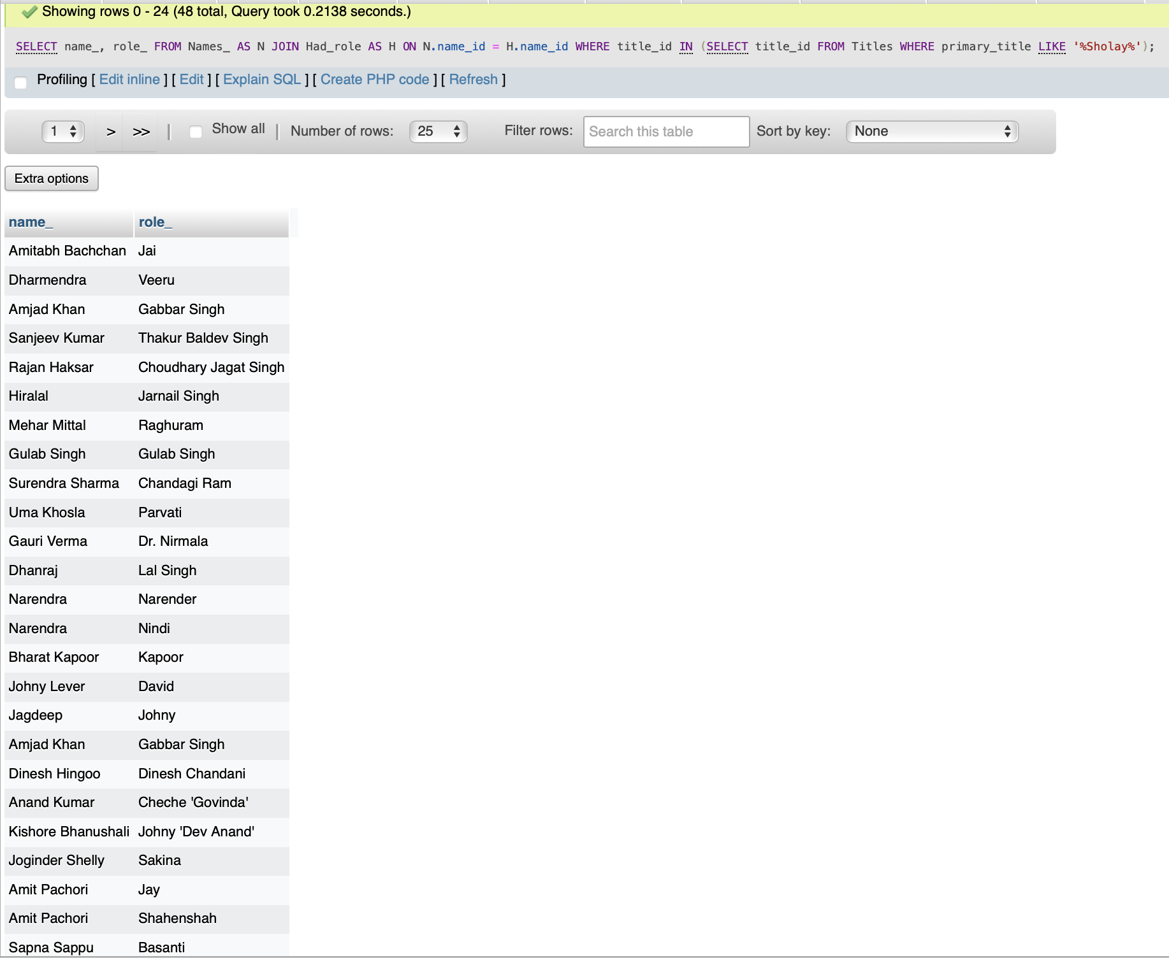
Join Query - 2

Slide 32
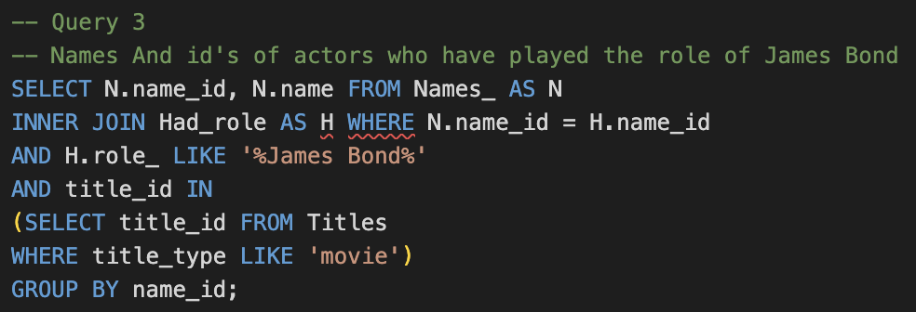
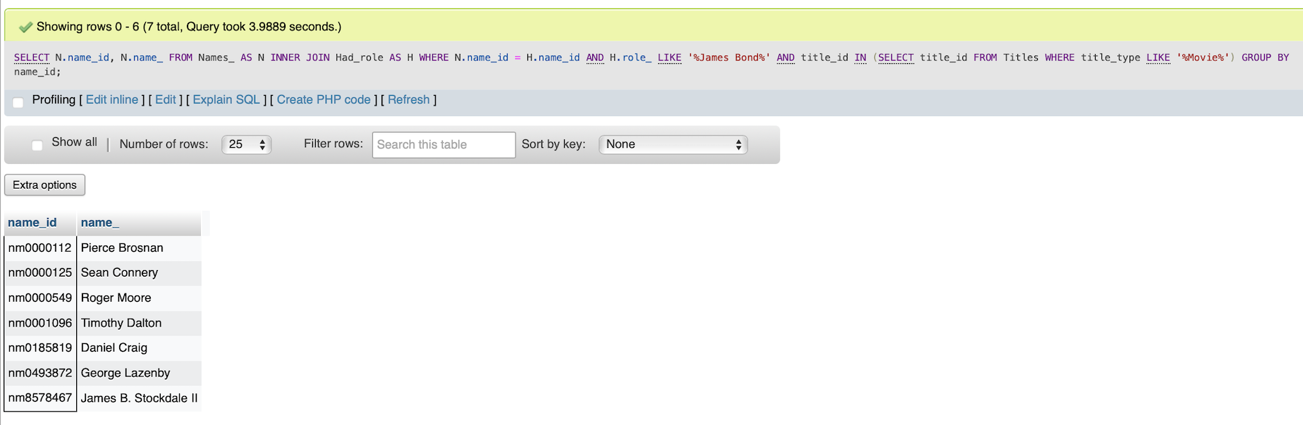
Join Query - 3

Slide 33
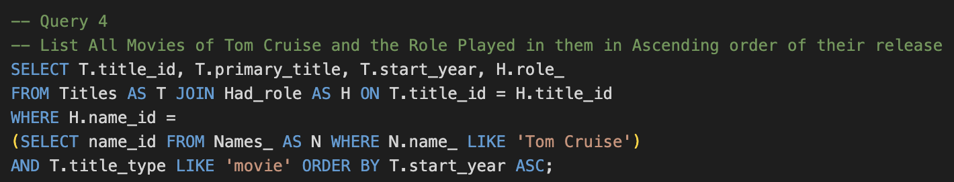
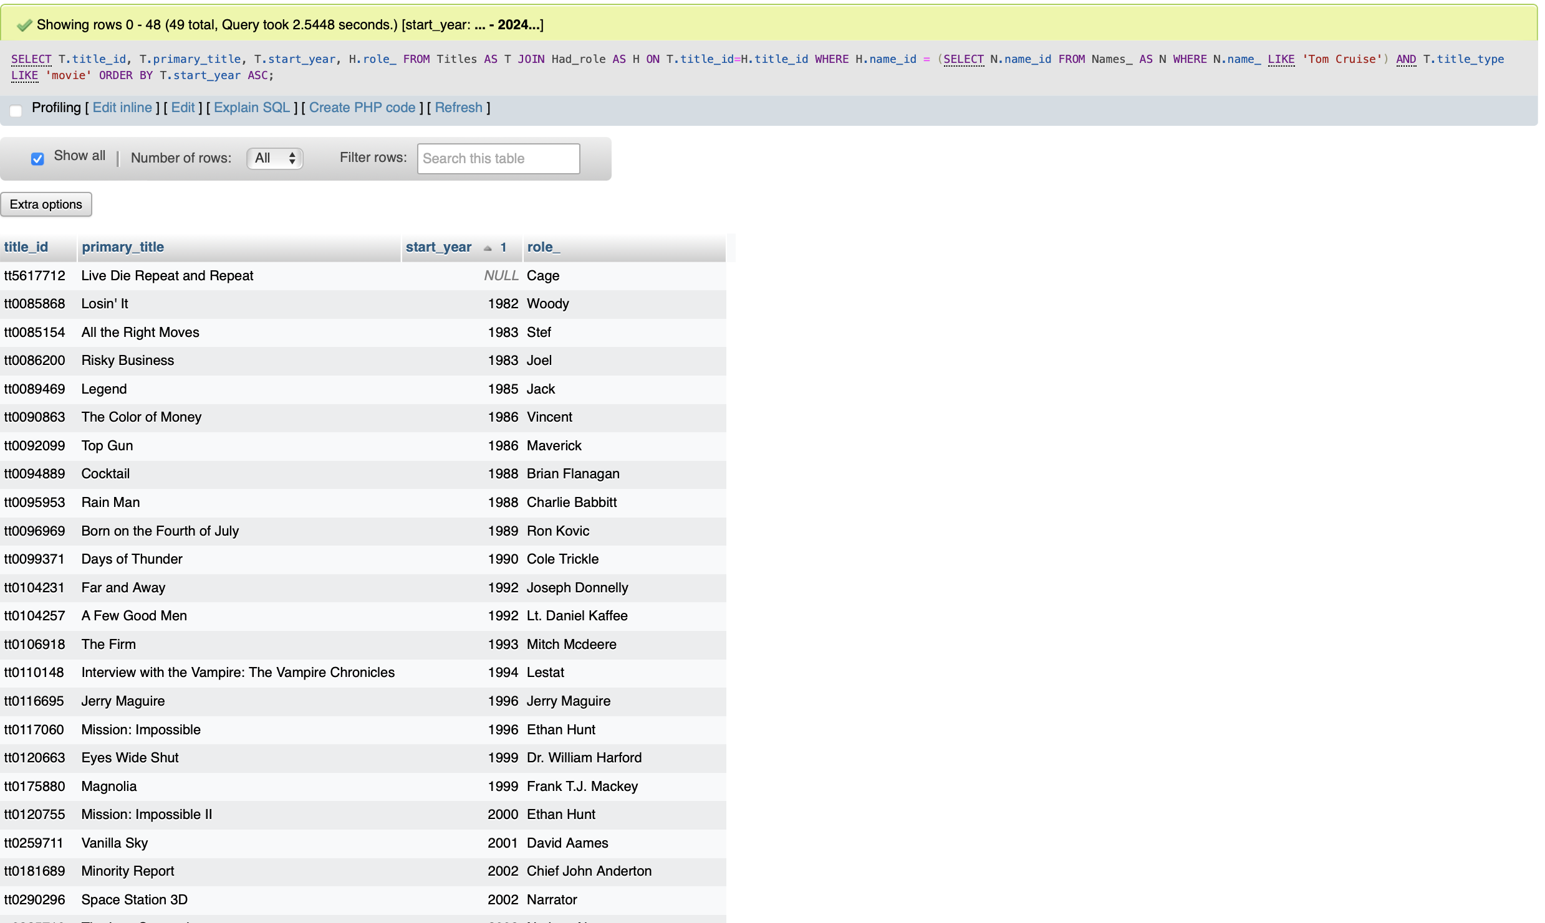
Join Query - 4

Slide 34
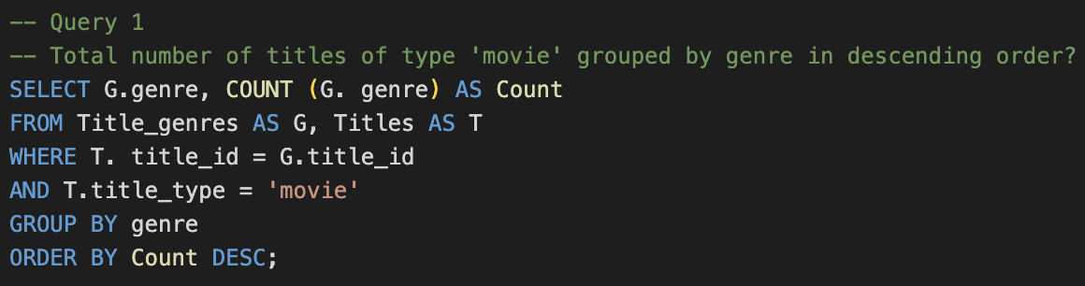
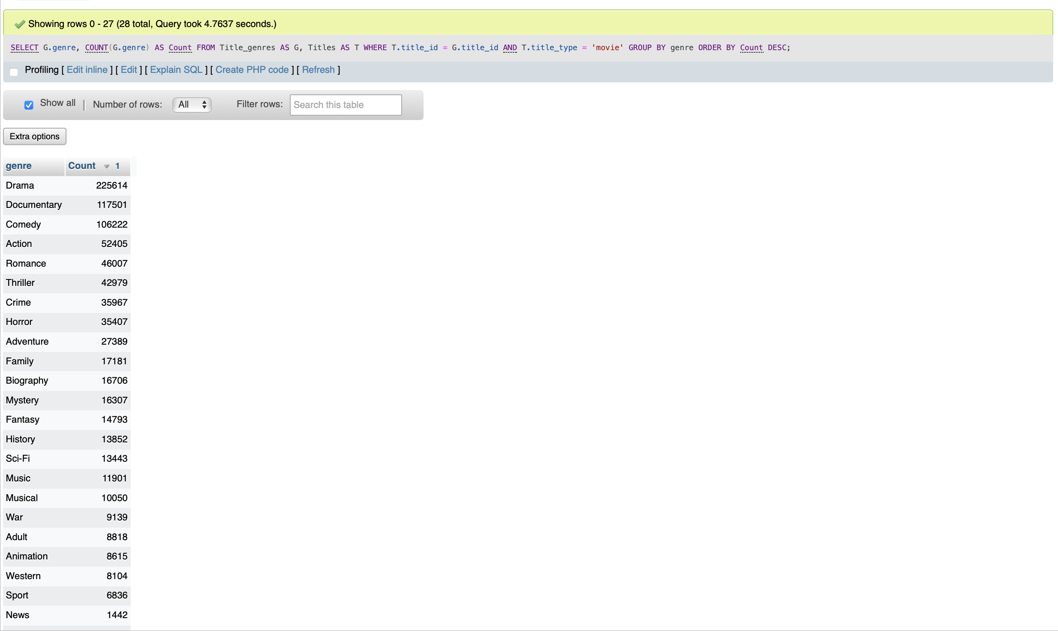
Aggregate Query - 1

Slide 35
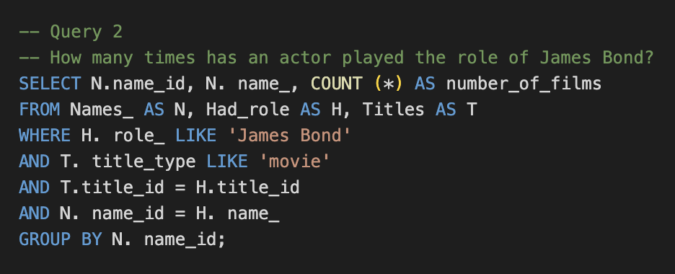
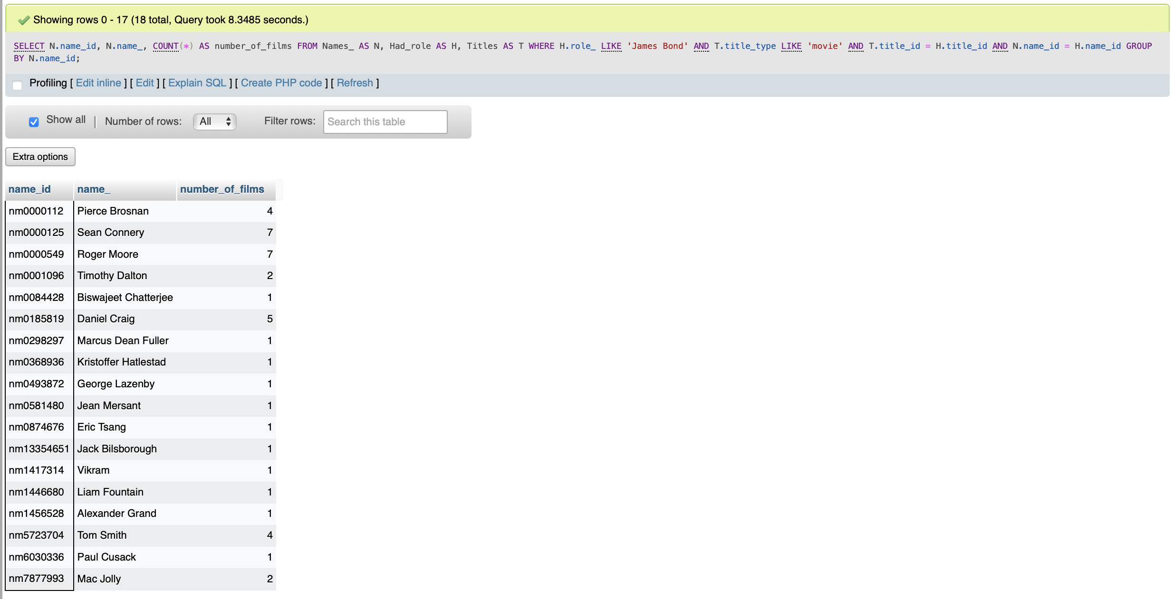
Aggregate Query - 2

Slide 36
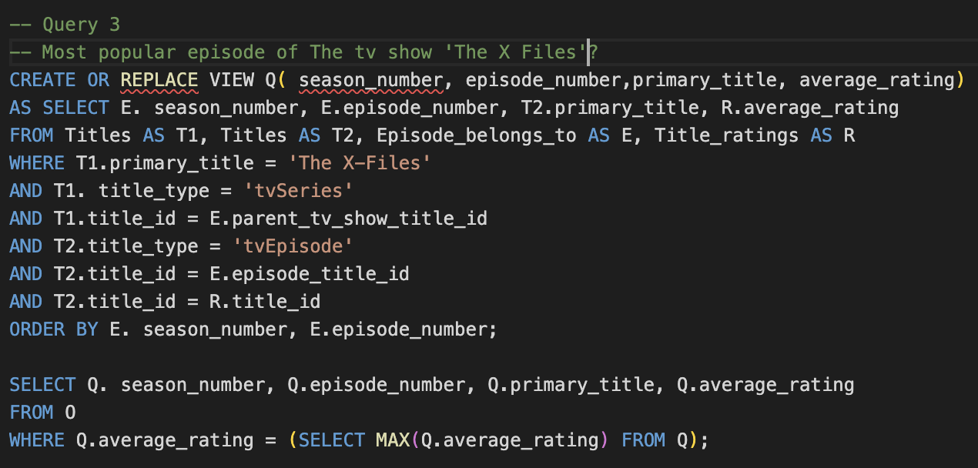
Aggregate Query - 3

Slide 37
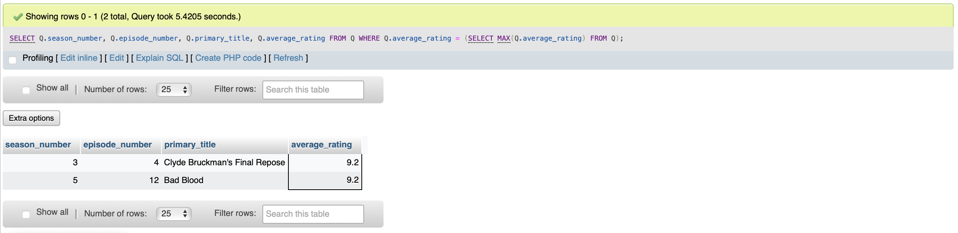
Aggregate Query Answer - 3

Slide 38
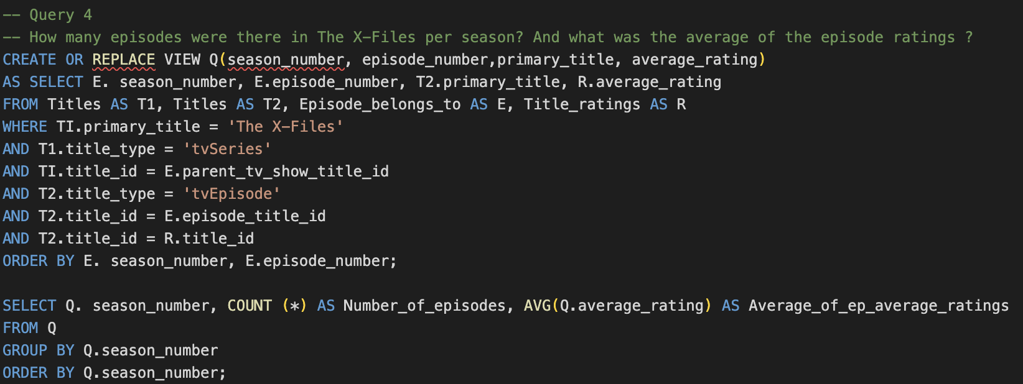
Aggregate Query - 4

Slide 39
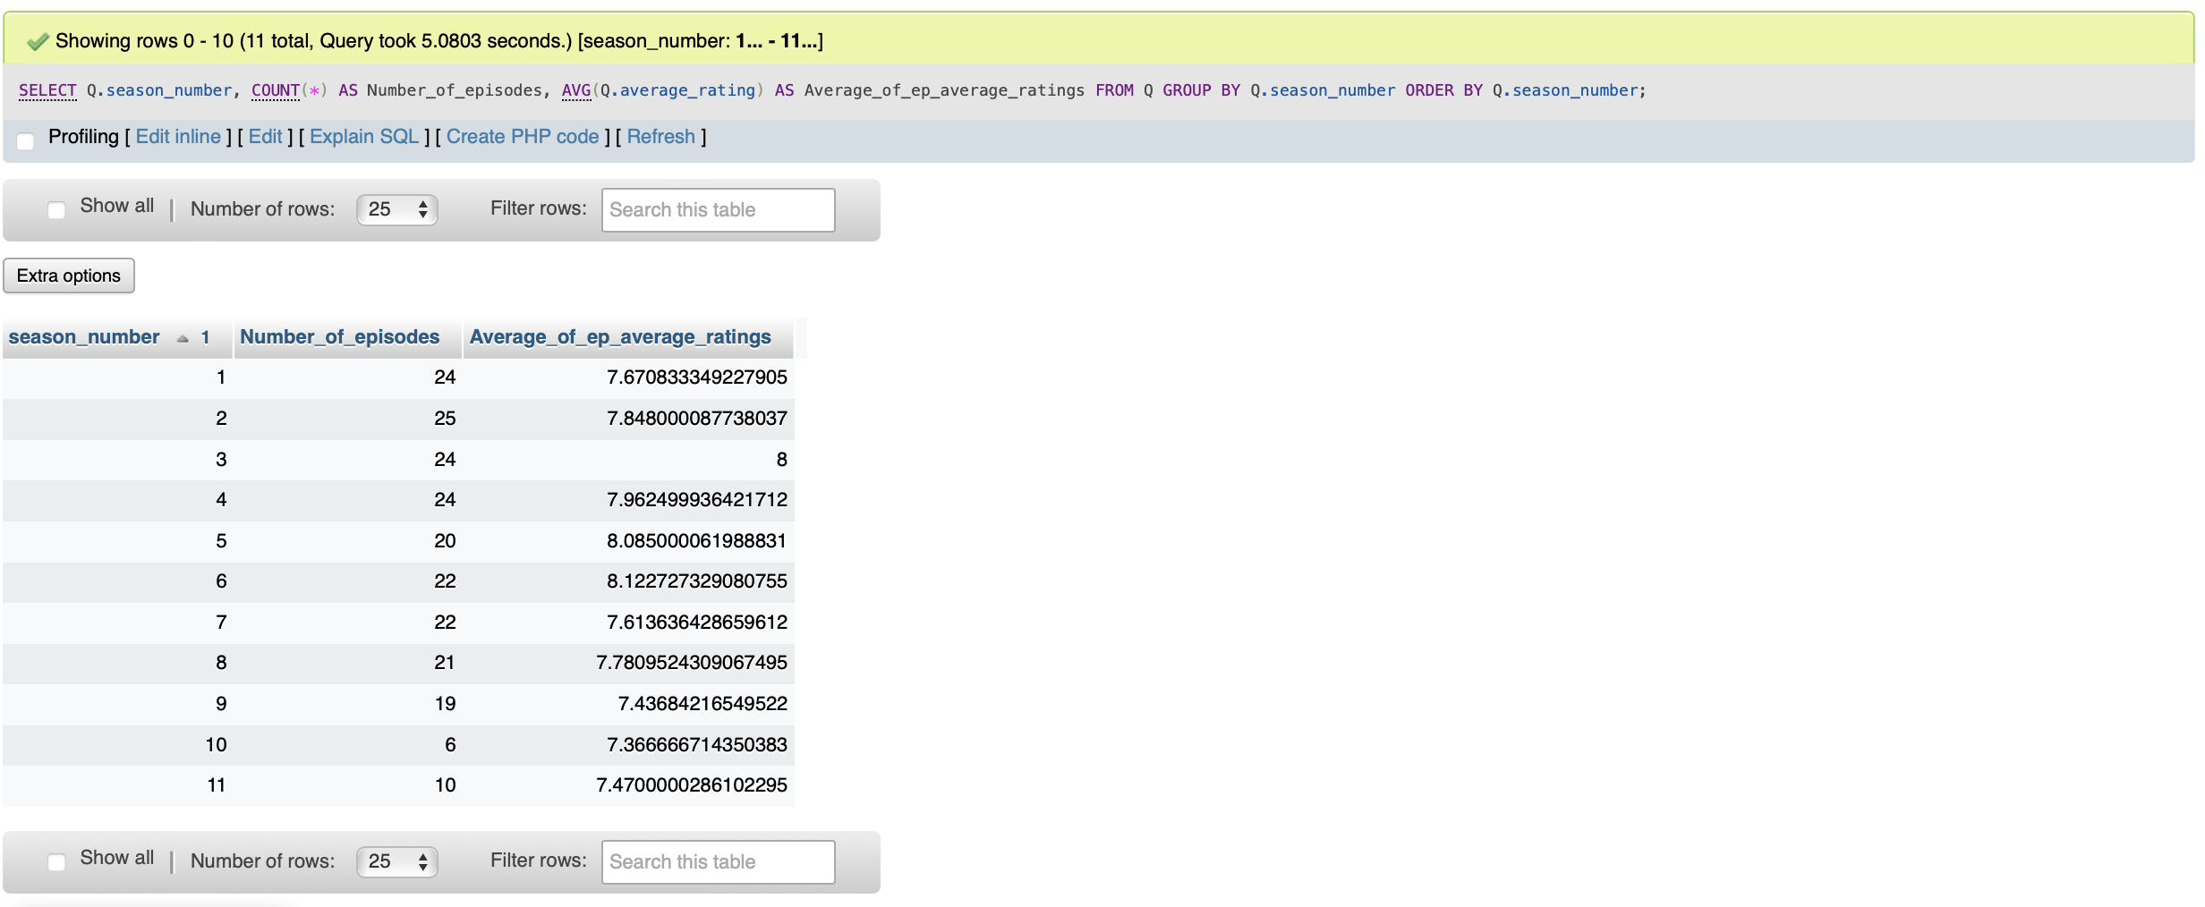
Aggregate Query Answer - 4

Slide 40
Set Query - 1

Slide 41
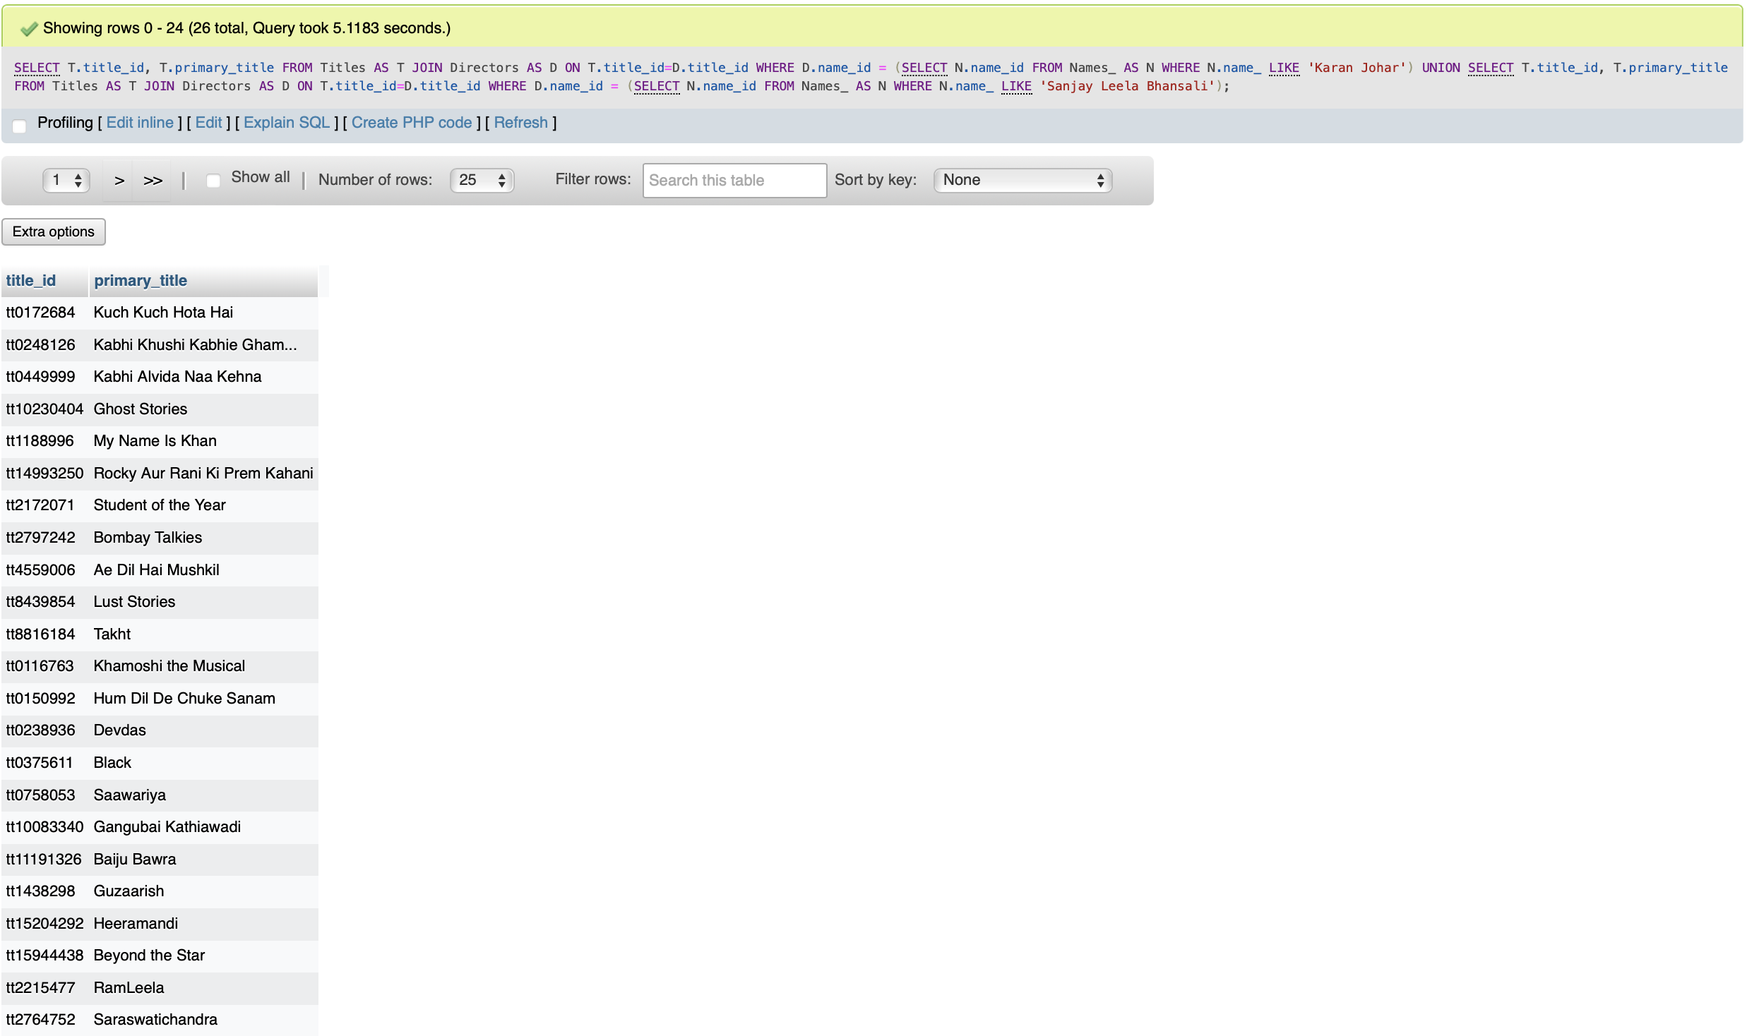
Set Query Answer- 1

Slide 42
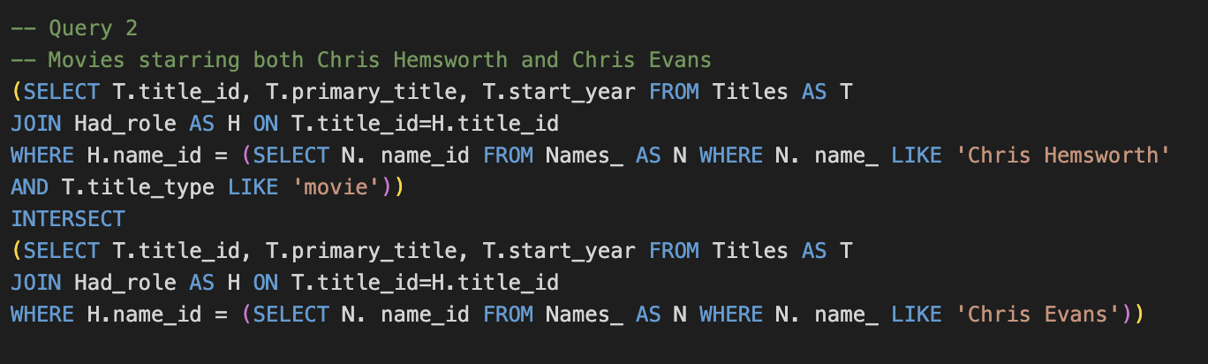
Set Query - 2

Slide 43
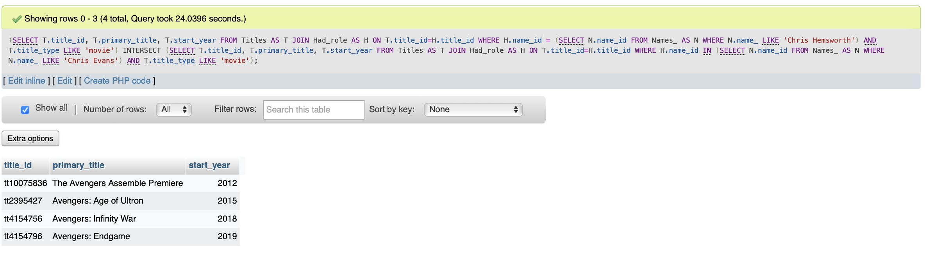
Set Query Answer- 2

Slide 44
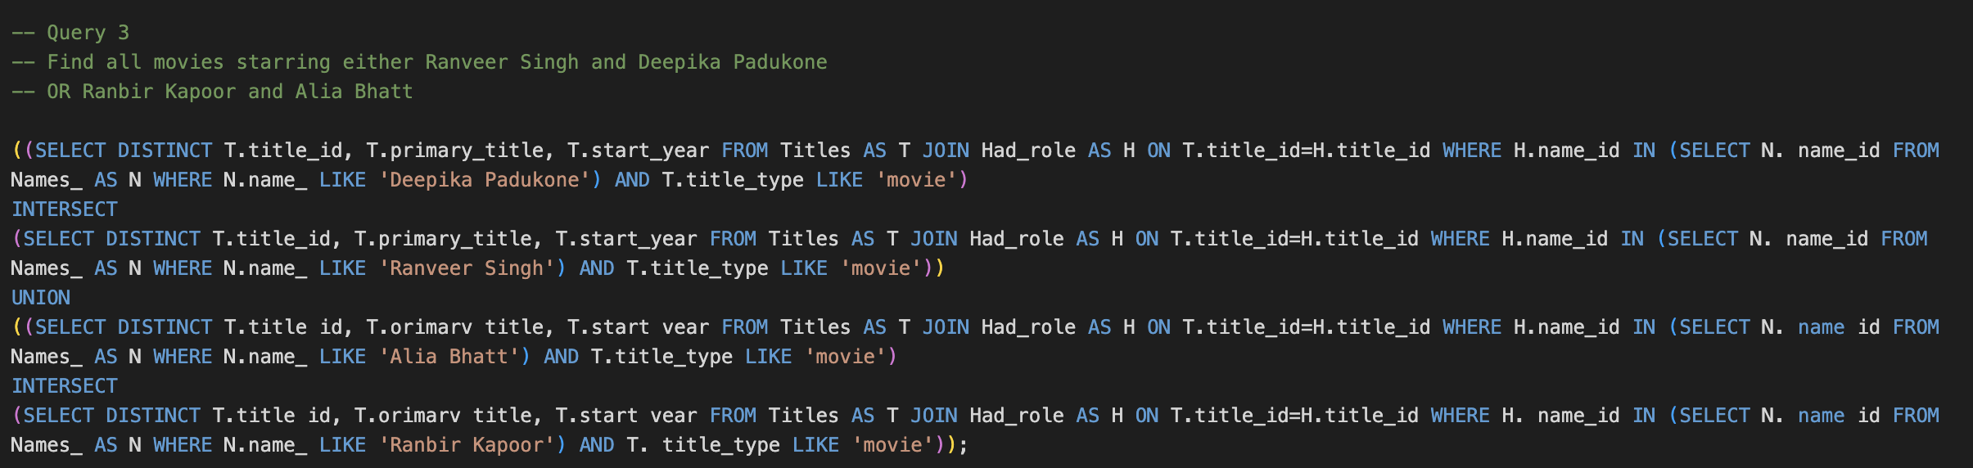
Set Query - 3

Slide 45
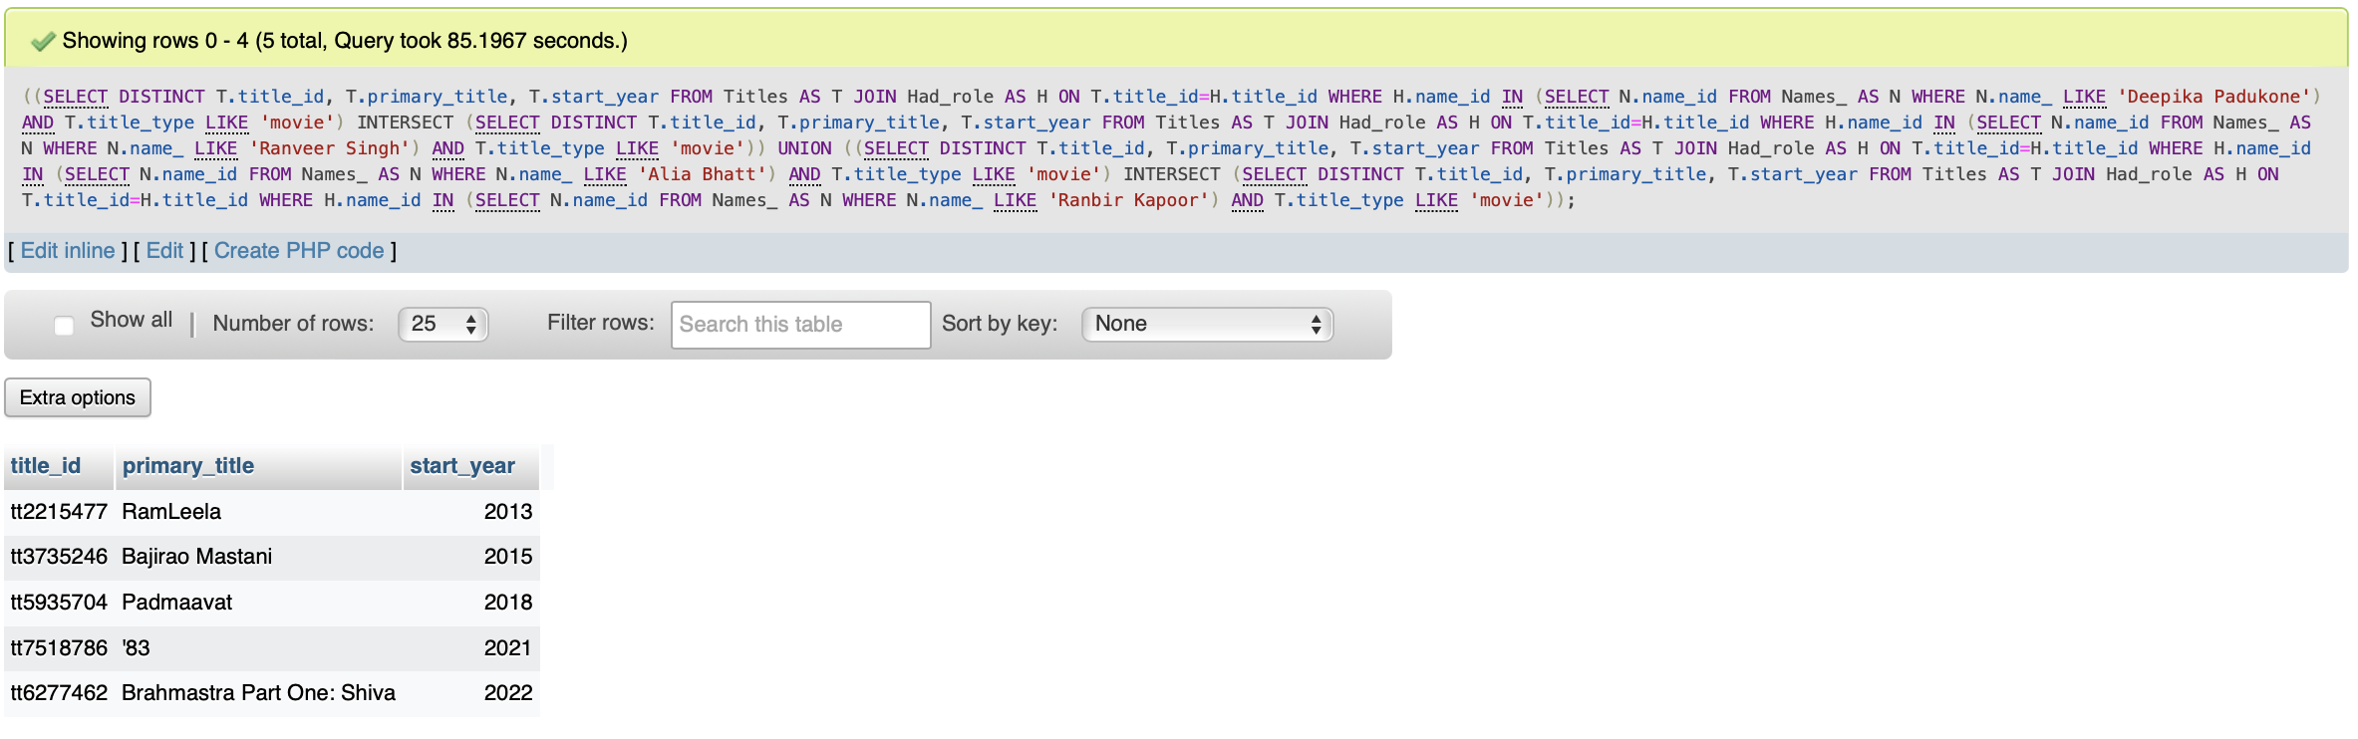
Set Query Answer- 3

Slide 46
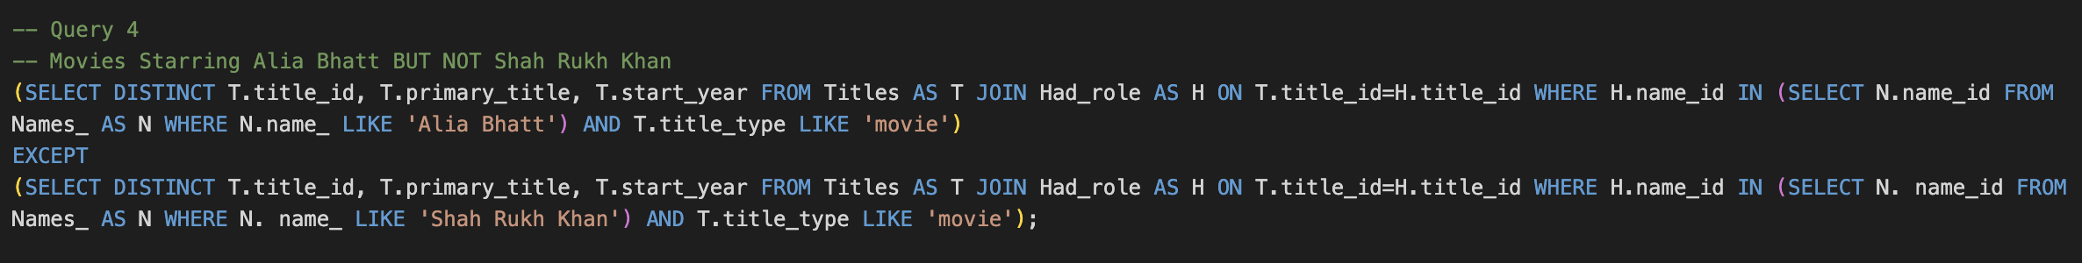
Set Query - 4

Slide 47
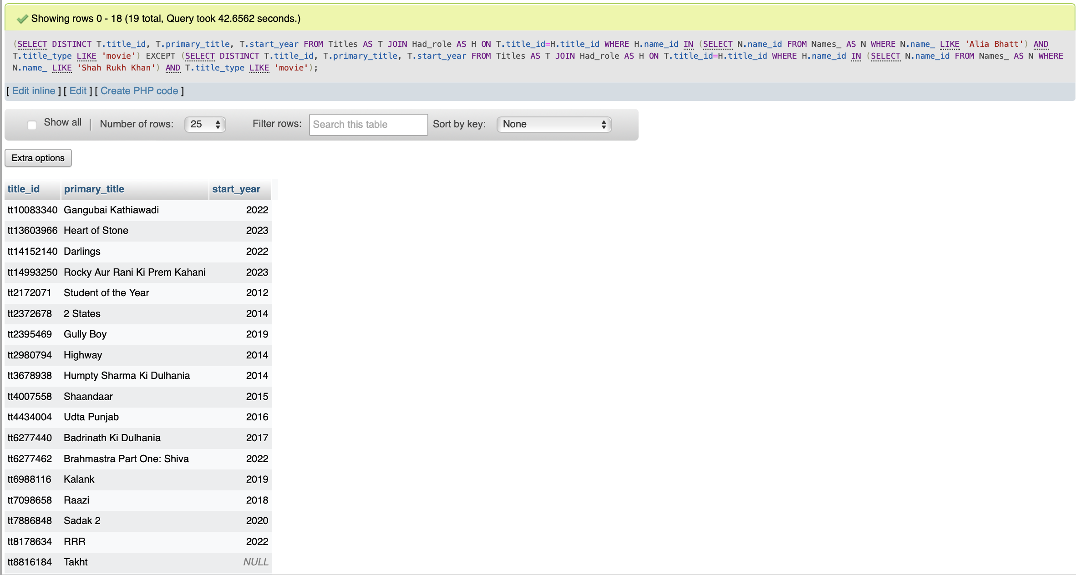
Set Query Answer- 4

Slide 48
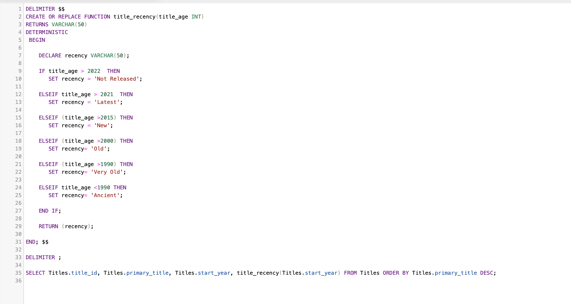
Function – To classify recency of a Title

Slide 49
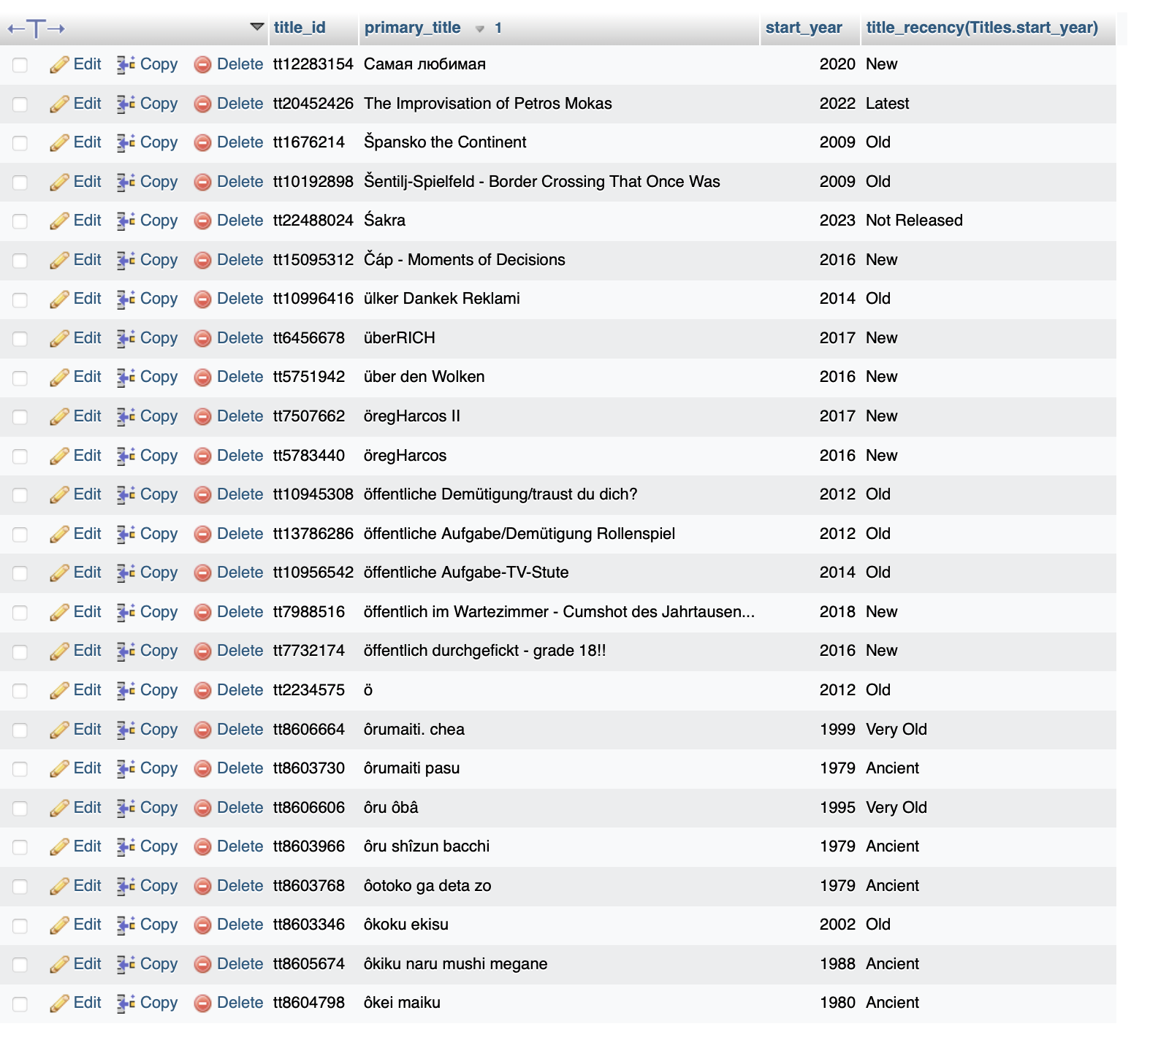
Function Output – To classify recency of a Title

Slide 50

Procedure – To Return The Number of Movies Directed By a Director

Slide 51

Procedure Output – To classify recency of a Title

Slide 52

Trigger – To prevent a name from being added IF birth year after 2022

Slide 53

Trigger Output – To prevent a name from being added IF birth year after 2022

Slide 54

Cursor – To Concatenate the Start Year and Death Year for Titles

Slide 55

Cursor Output – To Concatenate the Start Year and Death Year for Titles

Slide 56

Front-End Home Screen

Slide 57

Query Executor

Slide 58


Name Table: Add Name

Slide 59

Name Table: Edit Name

Slide 60

Name Table Output: Edit Name

Slide 61

Name Table: Delete Name

Slide 62
Name Table: Delete Name

Slide 63

Name Table Output: Delete Name

Slide 64

Titles Table: Add Title

Slide 65
Titles Table: Add Title

Slide 66

Titles Table: Edit Title

Slide 67
Titles Table Output: Edit Title

Slide 68

Titles Table: Remove Title

Slide 69

Titles Table: Remove Title

